Slide 1

BASIC ELECTRICAL ENGINEERING
D. C. KULSHRESHTHA,
PowerPoint Slides
PROPRIETARY MATERIAL. © 2010 The McGraw-Hill Companies, Inc. All rights reserved. No part of this PowerPoint slide may be displayed, reproduced or distributed in any form or by any means, without the prior written permission of the publisher, or used beyond the limited distribution to teachers and educators permitted by McGraw-Hill for their individual course preparation. If you are a student using this PowerPoint slide, you are using it without permission.

Slide 2
Chapter 3
Network Analysis–Part II
D.C. Kulshreshtha

Slide 3
Topics to be Discussed
Loop-current Analysis.
Counting Independent Loops.
Mesh Analysis.
Supermesh Method.
Limitations of Mesh Analysis.
Planar Network.
Procedure for Mesh Analysis.
Node Voltages Analysis.
Supernode.
Counting Independent Nodes.
Nodal Analysis.
Choice Between the TWO.

Slide 4
Loop-current Analysis
Loop analysis is systematic method of network analysis.
It is a general method and can be applied to any electrical network, howsoever complicated it may be.
It is based on writing KVL equations for independent loops.
A loop is a closed path in a network.
A node or a junction is a point in the network where three or more elements have a common connection.
Notes:
Examples of planar network Fig.5.21 ,22.

Slide 5
Before the loop analysis can be applied to a network, we must first check that it has only voltage sources (independent or dependent).
Any current source must be transformed into its equivalent voltage source.
Sometimes, it is a difficult task to identify independent loops in a network.
The method of loop analysis can be best understood by considering some examples.

Slide 6
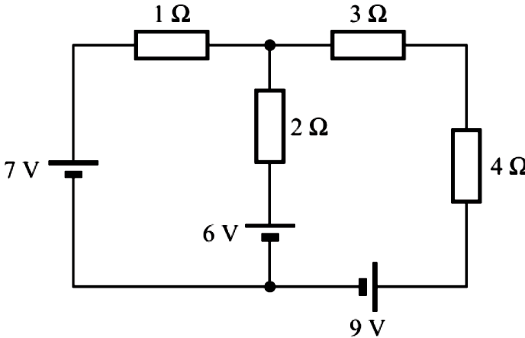
Example 1
Find the voltage across the 2-Ω resistance.

Slide 7
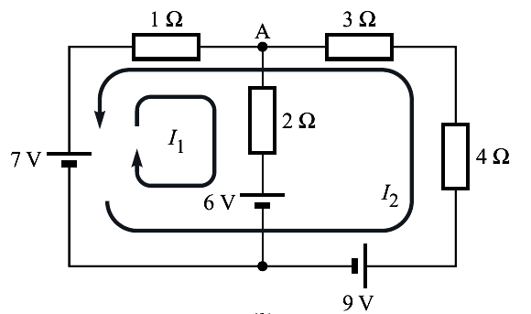
Recognize the independent loops (which do not pass through a current source), and mark the loop currents.
This choice reduces labour, as only one current I₁ is to be calculated.

Slide 8
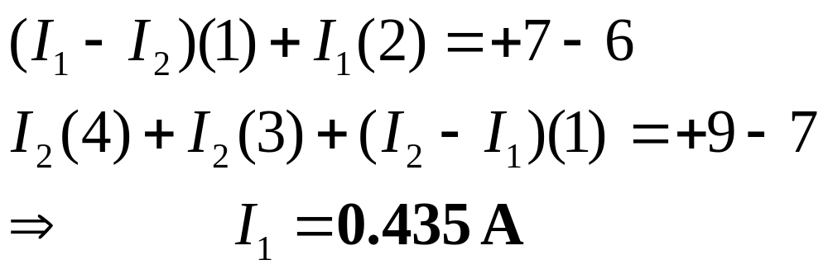
Write KVL equations and solve for I₁.

Slide 9
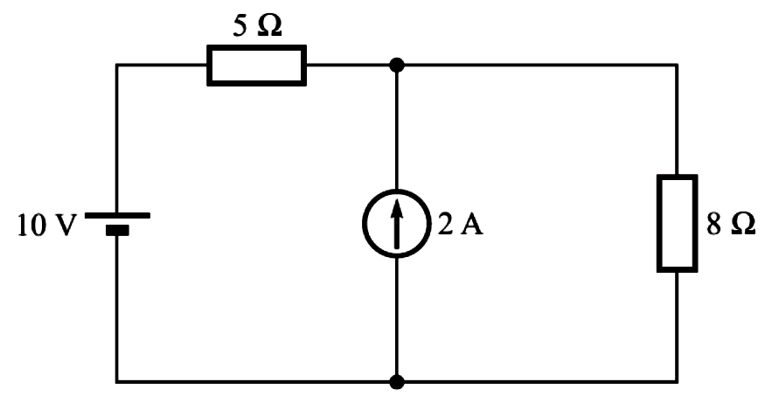
Counting Independent Loops
It appears to have two loops.
But, these two loops are not independent.

Slide 10
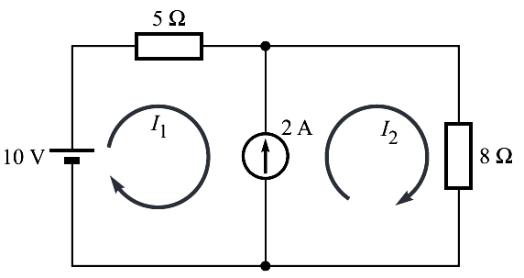
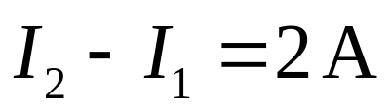
Suppose that we had marked the two loop currents I₁ and I₂ in the standard way,
Then,
The values of these two currents are constrained by the above relation.

Slide 11
We identify independent loops by turning off all sources. We are, then, left with one loop containing two resistances.
Hence, we have only one independent loop requiring only one KVL equation.

Slide 12
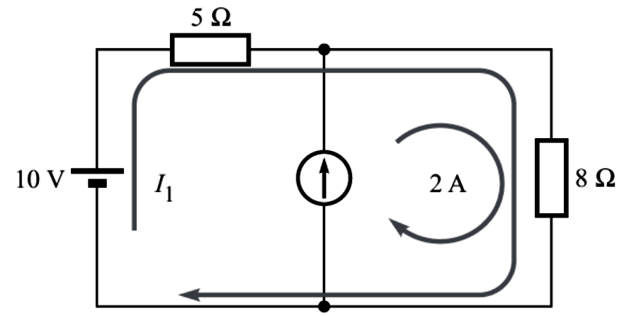
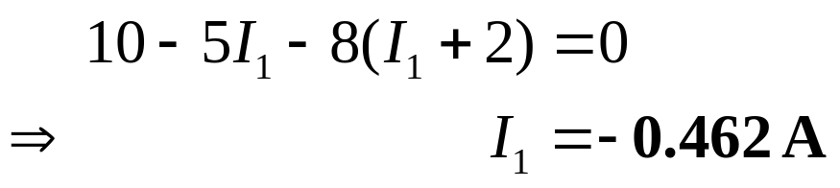
For determining the current through 5-Ω resistance, we should choose
Thus, the single KVL equation is

Slide 13
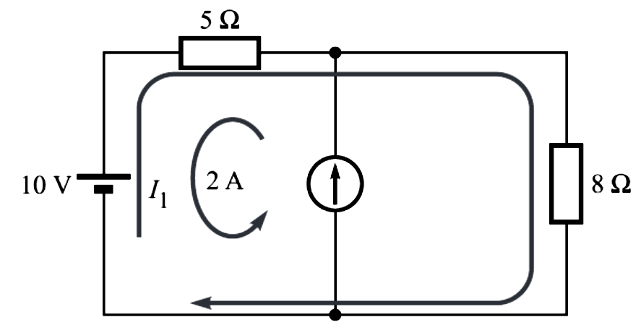
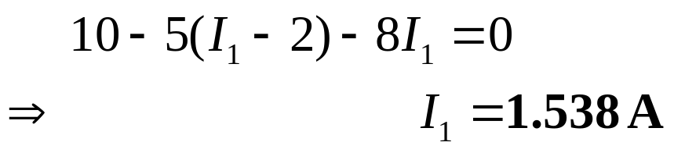
In case, we are to determine the current through 8-Ω resistance, we should choose
The single KVL equation then becomes

Slide 14
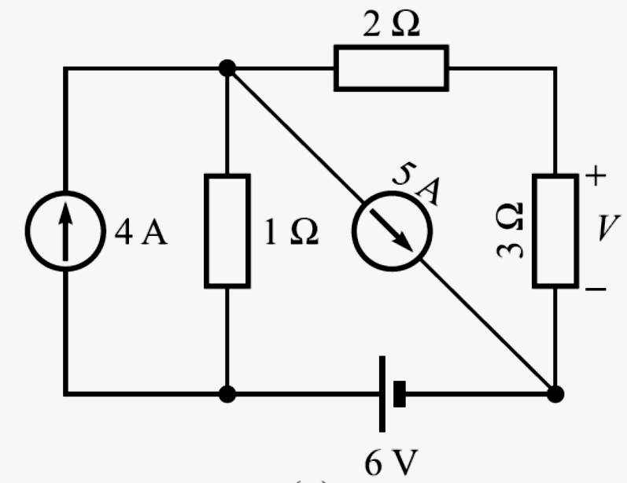
Benchmark Example 1
Consider the benchmark example, and solve it by using loop-current analysis.

Slide 15
Solution :
We note that the given circuit has one independent loop and two constrained loops.
Our aim is to determine the voltage across 3-Ω resistance.
So, we should select the unknown loop current I passing through 3-Ω resistance (but not through any current source).
The two known loop currents of 4 A and 5 A are marked to flow in the two loops as shown.

Slide 16
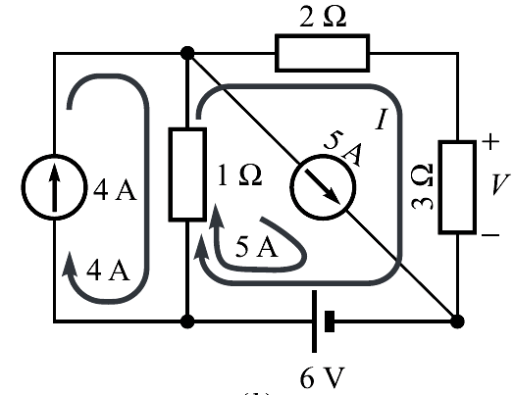
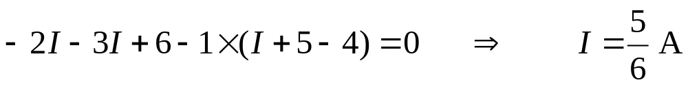
Writing KVL equation around the loop of I, we get
Therefore, the unknown voltage, v = 3I = 2.5 V.

Slide 17
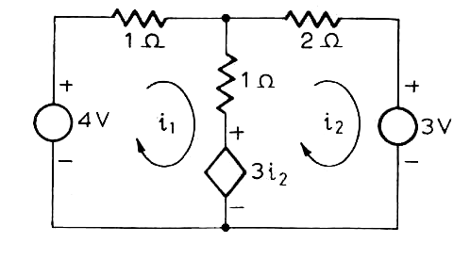
Example 2
Find the currents i₁ and i₂ in the circuit given below.

Slide 18
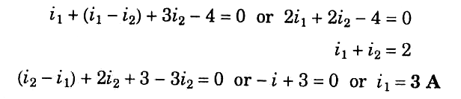
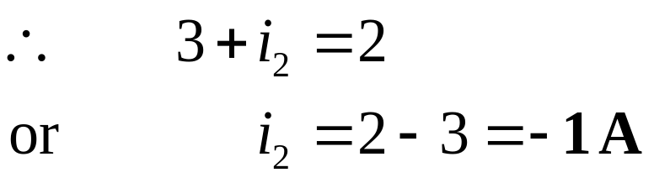
Solution : Applying KVL to the two loops,

Slide 19
MESH ANALYSIS
In circuit terminology, a loop is any closed path.
A mesh is a special loop, namely, the smallest loop one can have.
In other words, a mesh is a loop that contains no other loops.
Mesh analysis is applicable only to a planar network.
However, most of the networks we shall need to analyze are planar.

Slide 20
Once a circuit has been drawn in planar form, it often looks like a multi-paned window.
Each pane is a mesh.
Meshes provide a set of independent equations.

Slide 21
By definition, a mesh-current is that current which flows around the perimeter of a mesh. It is indicated by a curved arrow that almost closes on itself.
Branch-currents have a physical identity. They can be measured.
Mesh-currents are fictitious.
The mesh analysis not only tells us the minimum number of unknown currents, but it also ensures that the KVL equations obtained are independent.

Slide 22
Example 2
Let us consider a simple network having only two meshes.
Although the directions of the mesh currents are arbitrary, we shall always choose clockwise mesh currents.
This results in a certain error-minimizing symmetry.
Note that by taking mesh currents, the KCL is automatically satisfied.

Slide 23
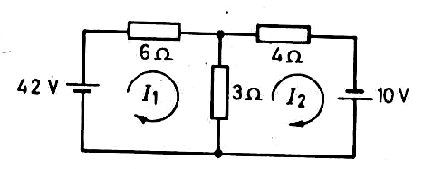
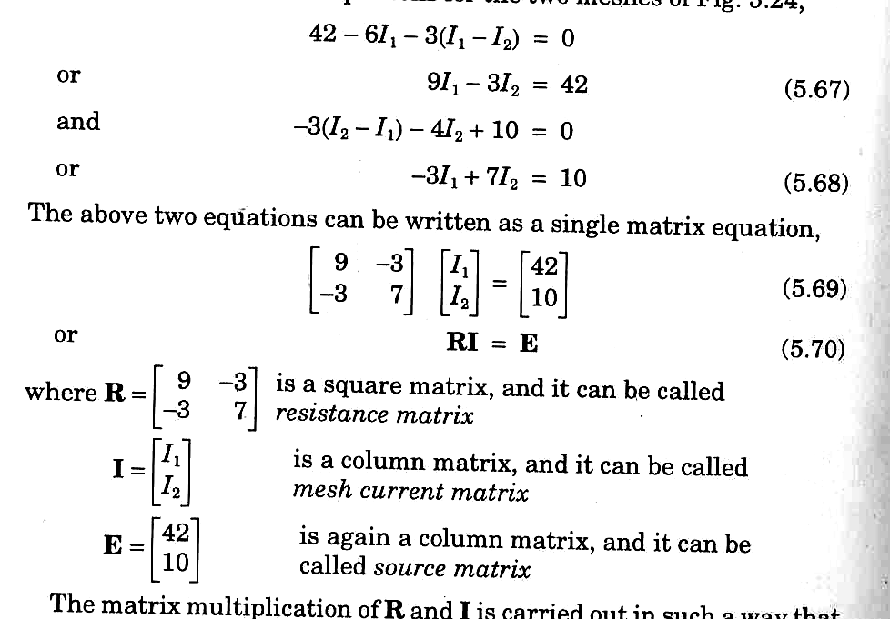

Slide 24
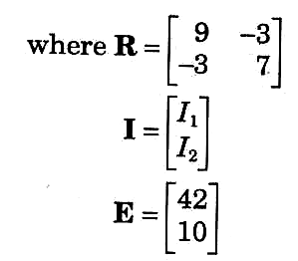
Resistance Matrix
Mesh current matrix
Source matrix

Slide 25
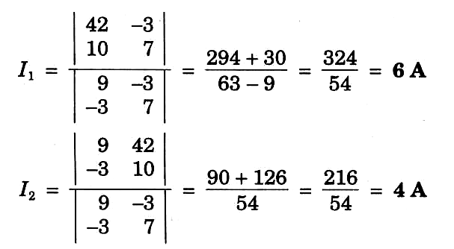
Applying Crammer’s rule :
The current in 3-ohm resistor is I₁ – I₂ = 6 – 4 = 2A

Slide 26
Scientific Calculator
Now-a-days, advanced scientific calculator (such as CASIO fx-991ES) are available.
Quadratic and simultaneous equations (up to three variables), can be directly solved just by keying in the constants of the equation.
Also, you can do calculations with complex numbers (even in mixed mode – polar and Cartesian), as is often required for the analysis of ac circuits
Using a good scientific calculator not only saves a lot of time, but also reduces the possibility of making errors.

Slide 27
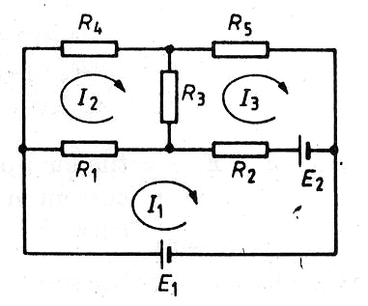
Three-mesh Network
Write the three equations for the three meshes and put them in a matrix form.

Slide 28
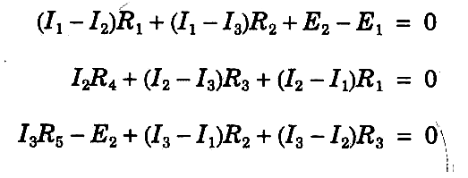
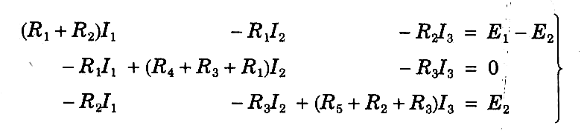

Slide 29
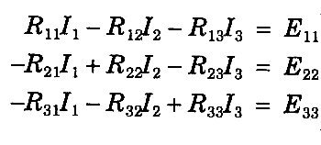
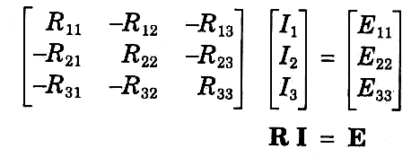

Slide 30
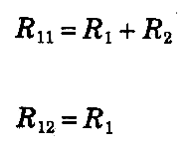

Self-resistance of mesh 1
Mutual resistance
between mesh 1 and 2.

Slide 31
The Resistance Matrix
It is symmetrical about the major diagonal, as R₁₂ = R₂₁, R₁₃ = R₃₁, etc.
All the elements on the major diagonal have positive values.
The off-diagonal elements have negative values.
The mutual resistance between two meshes will be zero, if there is no resistance common to them.

Slide 32
Mesh Analysis Limitations
It is applicable only to those planar networks which contain only independent voltage sources.
If there is a practical current source, it can be converted to an equivalent practical voltage source.

Slide 33
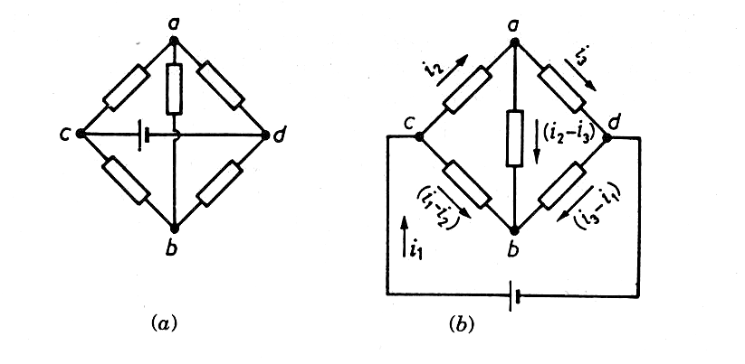
Planar Network
If a network can be drawn on sheet of paper without crossing lines, it is said to be planar.
Is it a planar network ?

Slide 34
Planar Network
If a network can be drawn on sheet of paper without crossing lines, it is said to be planar.
Is it a planar network ?
Yes, it is. Because it can be drawn in a plane, as shown in the next figure.

Slide 36
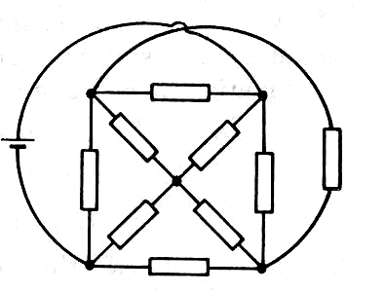
This is definitely non-planar.

Slide 37
Procedure for Mesh Analysis
Make sure that the network is planar.
Make sure that it contains only independent voltage sources.
Assign clockwise mesh currents.
Write mesh equations in matrix form by inspection. An element on the principal diagonal is the self-resistance of the mesh. These elements are all positive. An element off the major diagonal is negative (or zero), and represents the mutual resistance.

Slide 38
5. Check the symmetry of resistance matrix about the major diagonal.
An element of the voltage source column matrix on the right side represents the algebraic sum of the voltage sources that produce current in the same direction as the assumed mesh current.
Solve the equations to determine the unknown mesh currents, using Calculator (or Cramer’s rule).
Determine the branch currents and voltages.

Slide 39
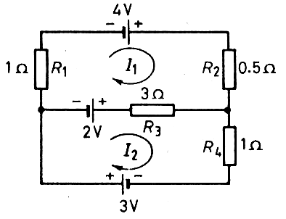
Example 3
Determine the currents in various resistances of the network shown.

Slide 40
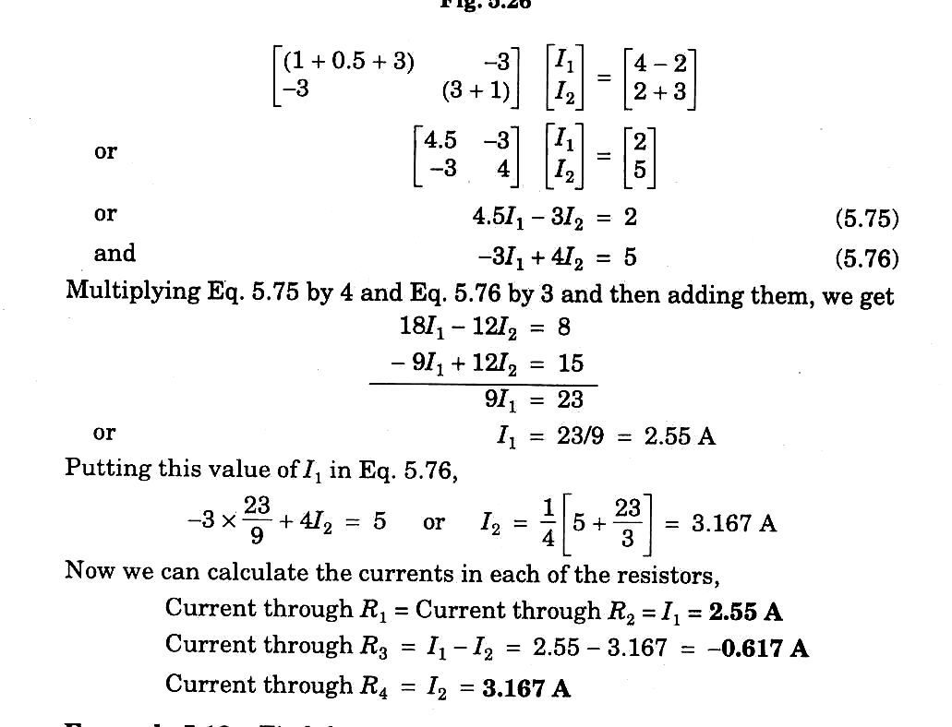
Writing the mesh equations by inspection,
Solving, we get I₁ = 2.55 A, I₂ = 3.167 A

Slide 41
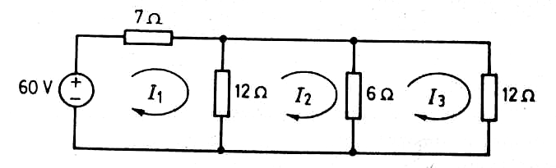
Example 4
Find the current drawn from the source in the network, using mesh analysis.

Slide 42
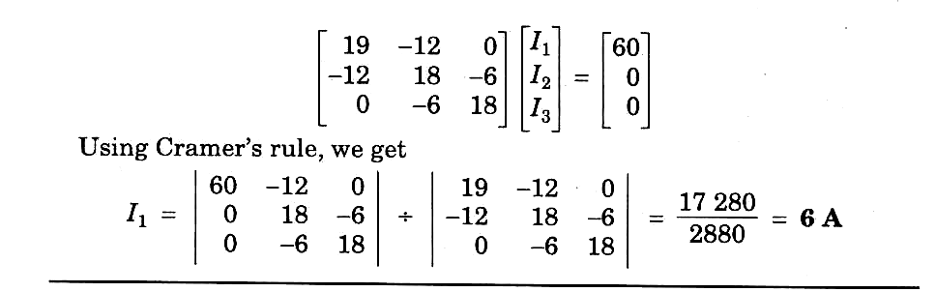

Slide 43
How to Handle Current Sources
If a circuit has current sources, a modest extension of the standard procedure is needed.
There are three possible methods.

Slide 44
First Method
If possible, transform the current sources into voltage sources.
This reduces the number of meshes by 1 for each current source.
Apply the standard procedure of mesh analysis to determine the assumed mesh currents.
Go back to the original circuit, and get additional equations, one for each current source,

Slide 45
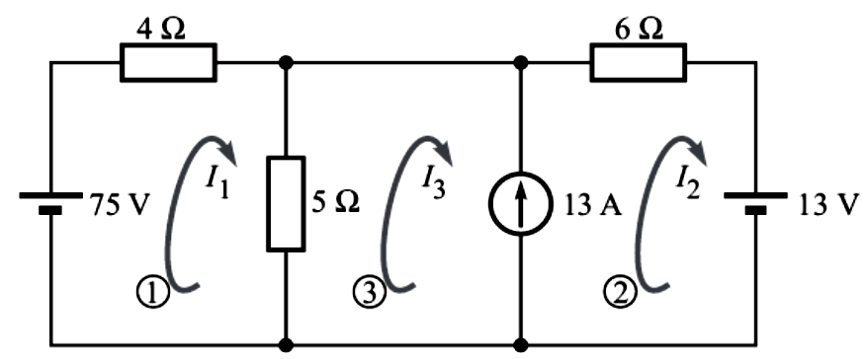
Example 5
Solve the following circuit for the three mesh currents.

Slide 46
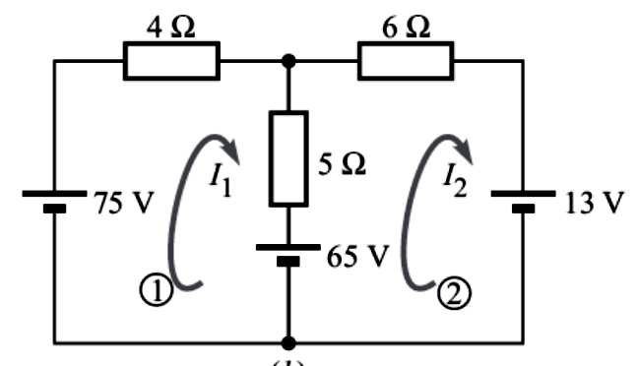
Solution :
We convert the 13-A current source in parallel with 5-Ω resistor into an equivalent 65-V voltage source in series with 5-Ω resistor.
This reduces the number of meshes to two.

Slide 47
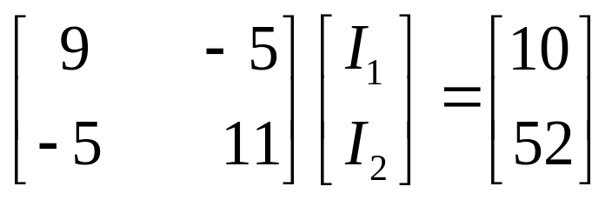
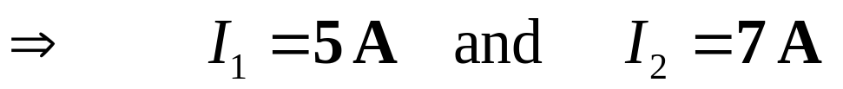
We can write the mesh equations in the matrix form just by inspection,
We now go back to the original circuit. Obviously, the current through the current source is

Slide 48
Second Method
We can assign unknown voltages to each current source.
Apply KVL around each mesh, and
Relate the source currents to the assumed mesh currents.
This is generally a difficult approach.

Slide 49
Third Method
(Supermesh Method)
Create a supermesh from two meshes that have a current source as a common element.
The current source is in the interior of the supermesh.
Thus, the number of meshes is reduced by 1 for each current source present.
If the current source lies on the perimeter of the circuit, then ignore the single mesh in which it is found.
Apply KVL to the meshes and supermeshes.

Slide 50
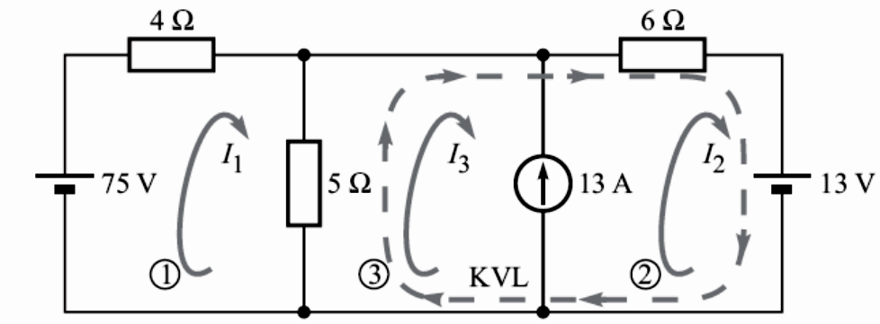
Example 6
Solve the circuit of Example 5, using supermesh method.
Solution :

Slide 51
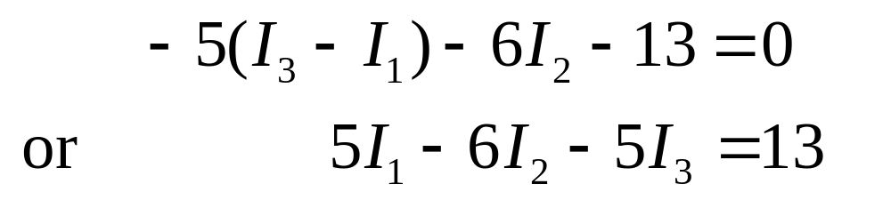
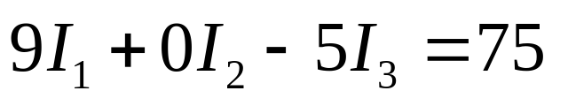
Going along the dotted arrow, the KVL equation for this supermesh is
The KVL equation for mesh 1 is
We have only two equations for three unknowns.
The third equation is obtained by applying KCL to either node of the current source

Slide 52
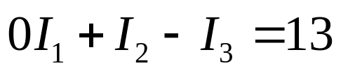
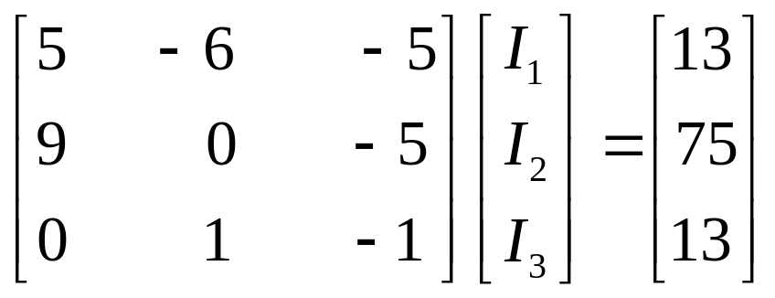
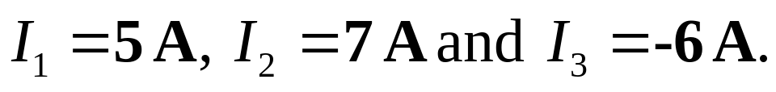
Thus, we have
These three equations can be put in the matrix form,
Using Casio fx-991ES, we directly get
Which is same result as obtained in Example 5.

Slide 53
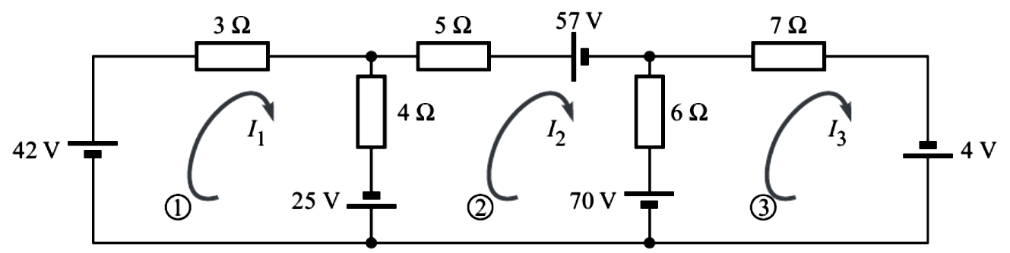
Example 7
Apply mesh analysis to determine current through 7-Ω resistance in the given network.

Slide 54
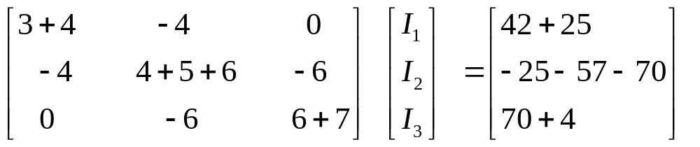
Solution :
The given network is a planar network having independent voltage sources.
It has three meshes for which the mesh currents I₁, I₂, and I₃ are marked all with clockwise directions.
By inspection, the matrix equation is written as

Slide 55
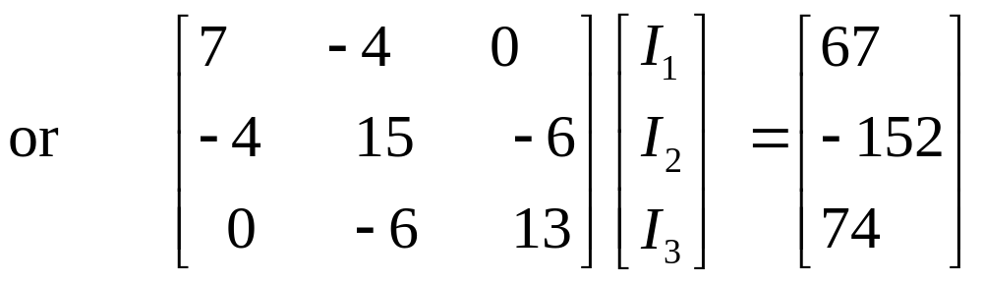
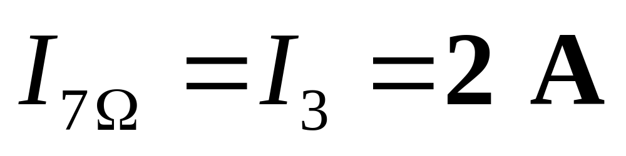
Please solve the above equation for I₃.
Using calculator (fx-991-ES), we get the current through 7-Ω resistance as

Slide 56
Node Voltages Analysis
It is dual of the Mesh Analysis.
It involves the application of KCL equations, instead of KVL.
One of the nodes is taken as reference or datum or ground node. It is better to select the one that has maximum number of branches connected.
The reference node is assumed to be at ground or zero potential.

Slide 57
The potentials of all other nodes are defined w.r.t. the reference node.
KCL equations are written, one for each node, except the reference node.
The equations are solved to give node voltages.
Current through any branch and voltage at any point of the network can be calculated.

Slide 58
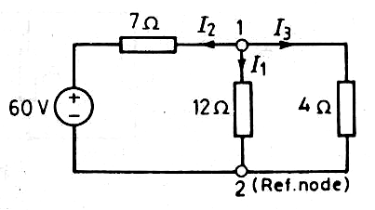
Example 8
Solve the circuit given, using the node voltage method.

Slide 59
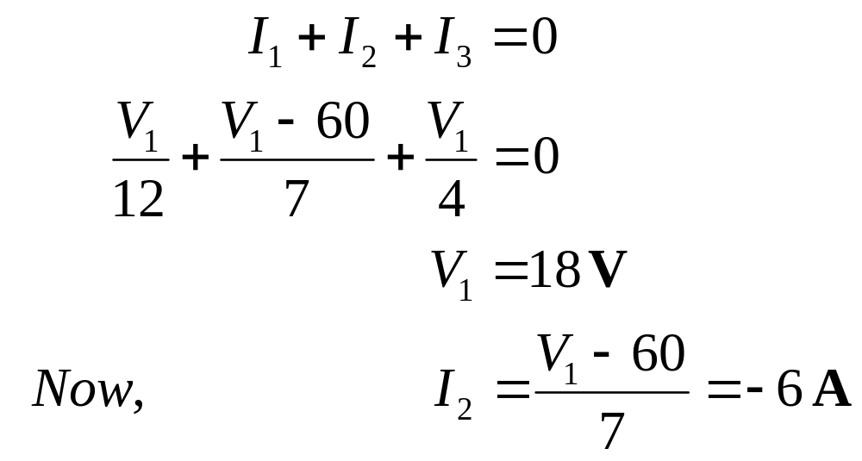
Solution : It has only two nodes. Node 2 has been taken as reference node. The currents in various branches have been assumed. Writing the KCL equations,

Slide 60
How to Handle Voltage Sources
If one terminal of a voltage source with a series resistance is grounded (as in the Example 8), the KCL equation can be written in terms of this voltage.
Difficulty arises, if a circuit contains floating voltage sources.
A voltage source is floating if its neither terminal is connected to ground.
If possible, first transform the voltage sources into current sources.

Slide 61
Constrained Node or SUPERNODE
There is another way which uses the concept of constrained node or supernode.
This method is especially suitable for the circuits having a floating voltage source with no series resistance.
The two ends of a voltage source cannot make two independent nodes.
Hence, we treat these end nodes together as a ‘supernode’.
The supernode is usually indicated by the region enclosed by a dotted line.
The KCL is then applied to both nodes at the same time.

Slide 62
Counting Independent Nodes
It is a node whose voltage cannot be derived from the voltage of another node.
First turn off all sources, and then counting all the nodes separated by resistors.
The number of independent nodes is one less than this number.

Slide 63
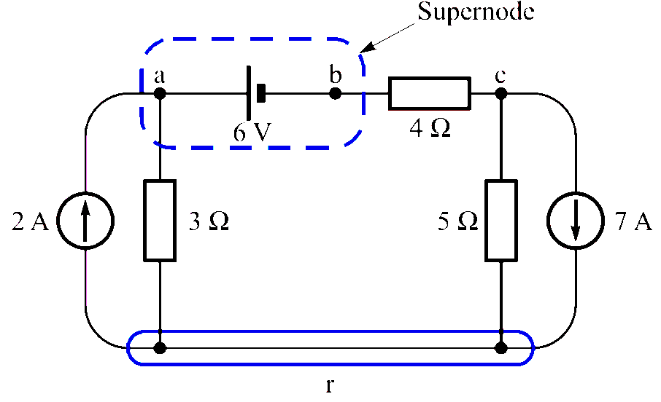
Example 9
Determine the current through 4-Ω resistor in the circuit given below.

Slide 64
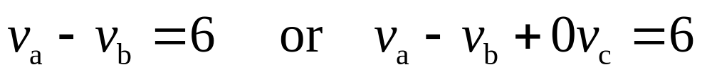

Solution :
Here, the voltages at nodes a and b are not independent.
The two node voltages are related as
We can treat the two constrained nodes a and b, as a supernode.
Now, writing KCL for this supernode, we get

Slide 65


Applying KCL to node c
Above equations can be written in the matrix form,
Solve the above equation

Slide 66

We solve the above equations using calculator to get
Finally, the current through 4-Ω resistor is

Slide 67

Benchmark Example 10
Consider the benchmark example and solve it by using node-voltage analysis.

Slide 68

Solution :
Nodes c and d are constrained to one another.
To find the number of independent nodes, we turn off the sources to get the circuit,

Slide 69
There are three nodes, two of which are independent.
However, if we add the two series resistors to make a 5-Ω resistor we will have only one independent node (node a).
Hence we will have to solve only one equation.
The unknown voltage across 3-Ω resistor can then be determined by applying voltage divider rule.

Slide 70
Benchmark Example 10
Consider the benchmark example and solve it by using node-voltage analysis.

Slide 71


Writing KCL equation for node a,
Using the voltage divider, the voltage across 3-Ω resistor is

Slide 72

Example 11
Apply KCL to determine current I_{S} in the circuit shown. Take V_{o} = 16 V.

Slide 73


Solution : Applying KCL at nodes 1 and 2,

Slide 74

Therefore, the current,

Slide 75

Example 12
Using nodal analysis, determine the current through the 2-Ω resistor in the network given.

Slide 76

Solution : It is much simpler to write the KCL equations, if the conductance (and not the resistances) of the branches are given.

Slide 77


It has 3 nodes. So, we have to write KCL equations for only 2 nodes.
We just equate the total current leaving the node through several conductances to the total source-current entering the node.
At node 1,
At node 2,

Slide 78

Using Crammer’s rule, we can solve the above two equations to get the node voltages.

Slide 80

Finally, the current in the 2-Ω resistor is calculated as

Slide 81
Nodal Analysis
The above examples suggests that it is possible to write the nodal analysis equations just by inspection of the network.
Such technique is possible if the network has only independent current sources.
All passive elements are shown as conductances, in siemens (S).

Slide 82
In case a network contains a practical voltage source, first convert it into an equivalent practical current source.
Write the Conductance Matrix, Node-Voltage Matrix and the Node-Current Source Matrix, in the same way as in the Mesh Analysis.

Slide 83
Example 13
Let again tackle Example 12, by writing the matrix equations just by inspection.

Slide 84



Conductance matrix.
G₁₁ = Self-conductance of node 1.
G₁₂= Mutual conductance
between node 1 and 2.

Slide 85
Node-voltage Matrix.
Node current-source Matrix.
Note that all the elements on the major diagonal of matrix G are positive.
All off-diagonal elements are negative or zero.

Slide 86

Example 14
Solve the following network using the nodal analysis, and determine the current through the 2-S resistor.

Slide 87

Solution :

Slide 88

We can write the nodal voltage equation in matrix form, directly by inspection :

Slide 89


Current through 2-S resistor is

Slide 90
Now, do the Problem again by using the Calculator, to see the difference.

Slide 91

Example 15
Find the node voltages in the circuit shown .

Slide 92

Solution :
First Method
Transform the 13-V source and series 5-S resistor to an equivalent current source of 65 A and a parallel resistor of 5 S

Slide 93


Now, we can write the nodal equations in matrix form for the two nodes just by inspection,
Now, from the original circuit shown, we get

Slide 94
Example 15
Find the node voltages in the circuit shown .

Slide 95



Second Method
We use the concept of supernode. The voltage source is enclosed in a region by a dotted line, as shown in figure.. The KCL is then applied to this closed surface:
The KCL equation for node 1 is
For three unknowns, we need another independent equation. This is obtained from the voltage drop across the voltage source,

Slide 96

Solving these three equations, we get
Which are the same as obtained by first method.
In general, for the supernode approach, the KCL equations must be augmented with KVL equations the number of which is equal to the number of the floating voltage sources.

Slide 97
Choice Between the TWO
We select a method in which the number of equations to be solved is less.
The number of equations to be solved in mesh analysis is
b – (n – 1)
The number of equations to be solved in nodal analysis is
(n – 1)

Slide 98
Review
Loop-current Analysis.
Counting Independent Loops.
Mesh Analysis.
Supermesh Method.
Limitations of Mesh Analysis.
Planar Network.
Procedure for Mesh Analysis.
Node Voltages Analysis.
Supernode.
Counting Independent Nodes.
Nodal Analysis.
Choice Between the TWO.

